Slide 1

Recommendations to the College Board
Roy Kim

Slide 2
Notes:
Social commentary on student intelligence?
But insight into the changing SAT, which is in response to the changing landscape of standardized testing

Slide 3
Background Information
Standardized college exams are tests made to be an objective reference point across states on the preparedness of students to succeed in college
Two major tests: SAT and ACT
Recent increase in state participation
Notes:
Do these standardized tests really measure a student’s ability to succeed in college? Maybe or maybe not.
But the truth of the matter is that they are ‘keys’ to college entrance

Slide 4
Goal
To analyze recent SAT and ACT data to inform the College Board on what state market to expand in.
Problem Statement
What market should the College Board pursue to increase SAT participation?

Slide 5
Approach
Collect SAT and ACT data from 2017 and 2018 and combine with relevant state information (median income, college bound percent, population, etc.).
Perform exploratory data analysis to understand relationships and patterns between different facets of data.
Assess data and choose a state “market” that the College Board can expand in
Research and analyze information about said state market and present findings

Slide 6
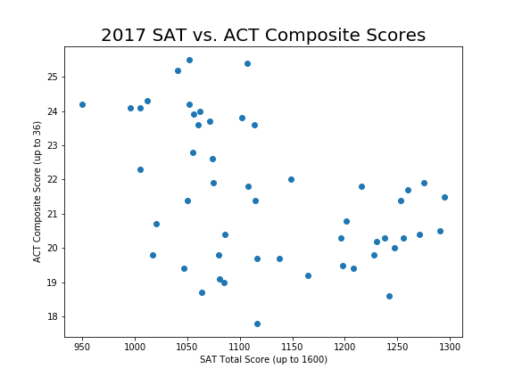
Step 1 Findings / Supporting Information
Notes:
- Extensive use of scatter plots in my findings
- 2017 SAT scores vs 2017 ACT scores

Slide 7
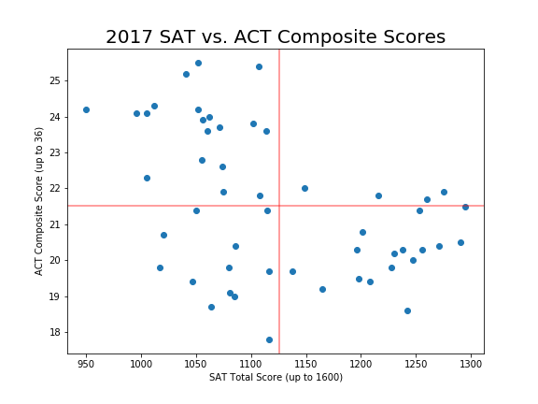
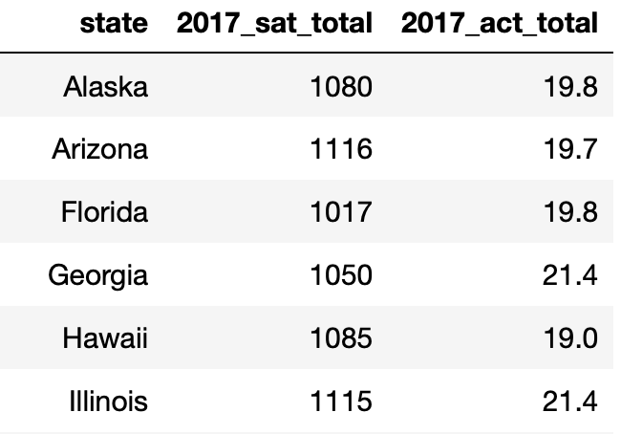
Step 1 Findings / Supporting Information
Bottom left quadrant are states with below average SAT and ACT scores in 2017
Notes:
- Red lines denote the average SAT and ACT score for every state
- Bottom left quadrant are states that performed below average on both tests!

Slide 8
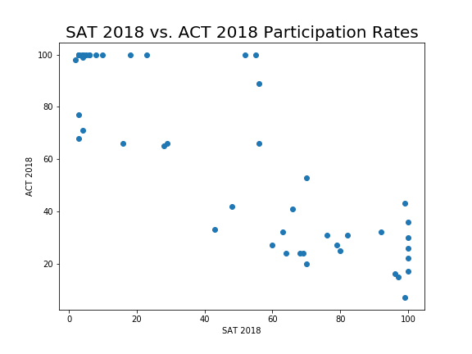
Step 2 Findings / Supporting Information
Notes:
- In the context of averages...

Slide 9
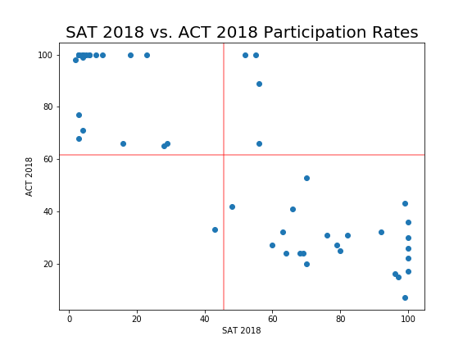
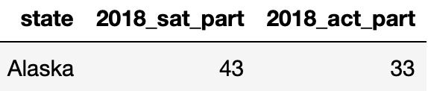
Step 2 Findings / Supporting Information
Only one state that has below average participation on ACT and SAT
Notes:
- Alaska is a 'battleground' state for the ACT and the College Board

Slide 10
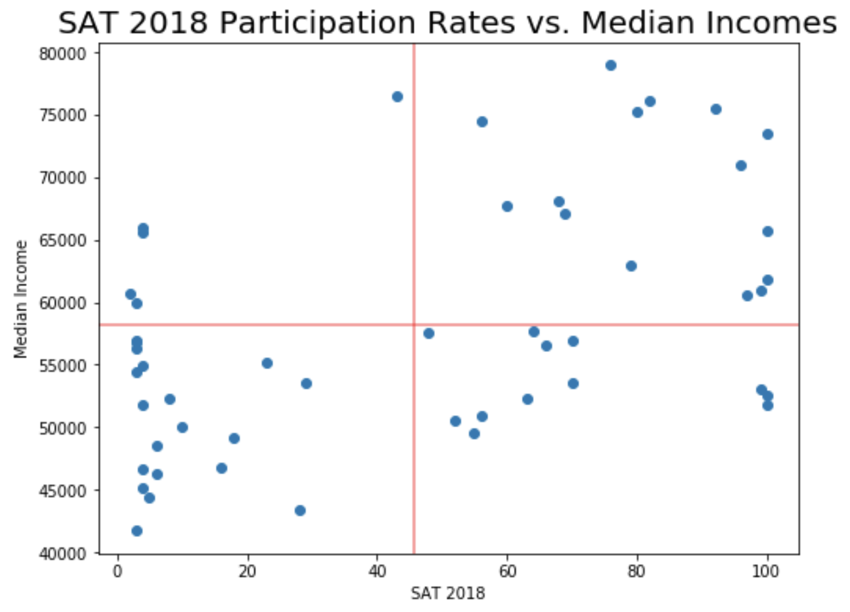
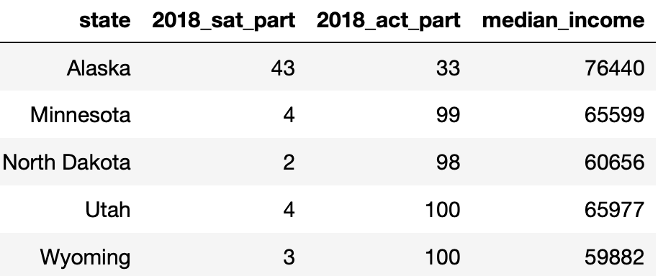
Step 3 Findings / Supporting Information
Potential markets: States with low SAT participation rates

Slide 11
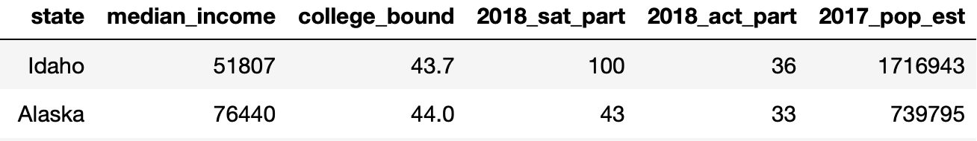
Deeper Research into Alaska
Alaska has the second lowest college-bound senior class amongst all 50 states
Alaska has a high median income due to the industries available for work (no higher education needed)
Alaska only has two universities
Most students go to other states for college (and don’t return)

Slide 12
Conclusion
Alaska’s students has performed below average on the SAT and ACT for 2017 and 2018
Alaska has below average participation on both the SAT and ACT
Alaska has a high median income but low college entrance rate
**The College Board and Alaska’s students can benefit from increased participation in the SAT**

Slide 13

Recommended Actions
Making the SAT more widely available (maybe mandatory) in Alaska would:
Prepare Alaskan students to be a more diverse workforce
Help future-proof Alaska
Improve quality of universities in Alaska
Notes:
Prepare Alaskan students to be a more diverse workforce
Help future-proof Alaska (as oil revenue might not always be there)
Improve both public and private universities in Alaska to have a larger student base, improving the higher education options Alaskans have

Slide 14
Next Steps / Questions
Work with school systems to encourage higher education participation
Work with legislators to
make SAT a state-funded test
re-evaluate secondary and higher education funding

